Slide 1
Windows 10 Lighting up your UI
Daren May
Windows Development MVP

Slide 2
What phone do you have in your pocket?

Slide 3
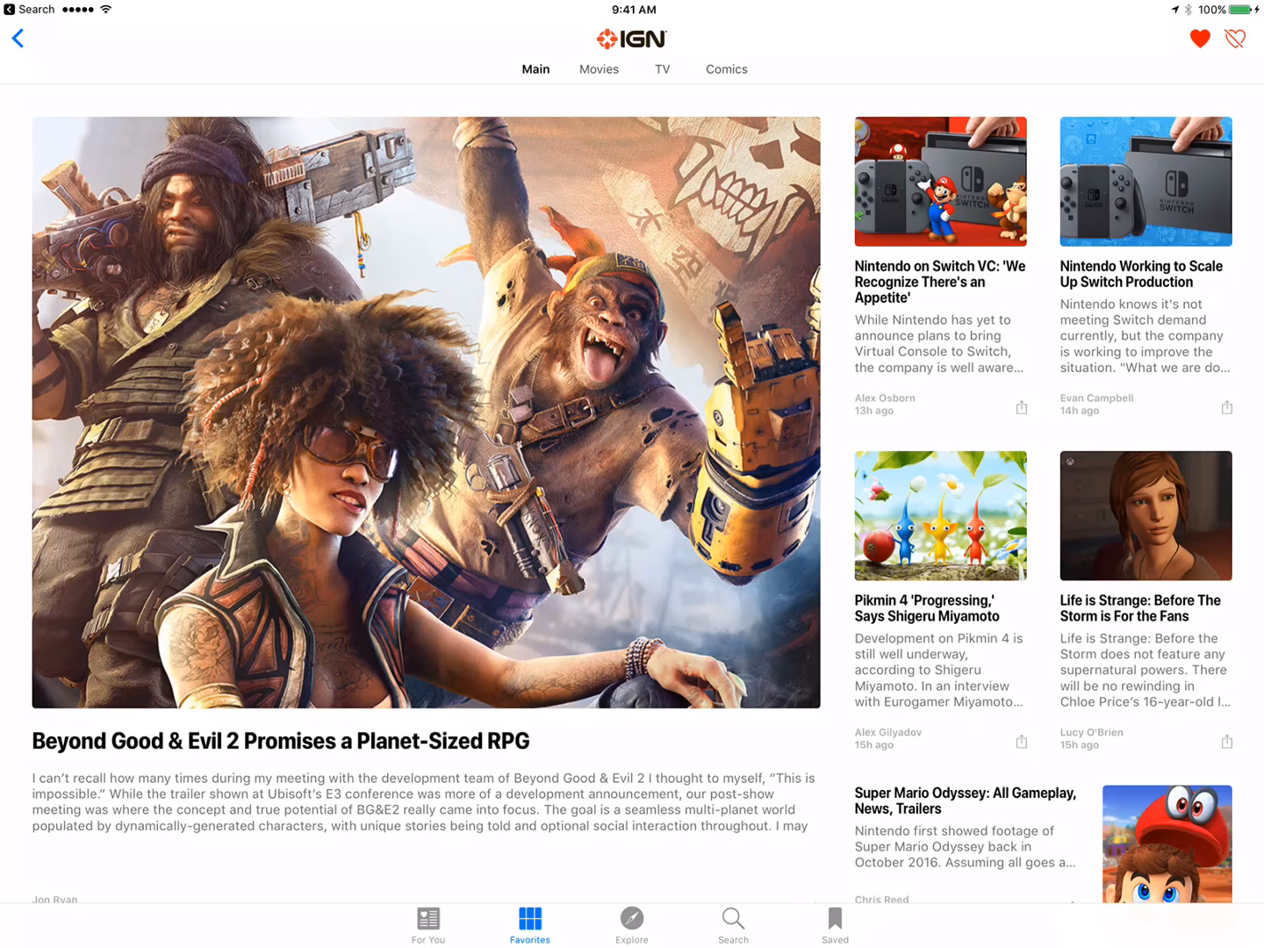
iOS News

Slide 4
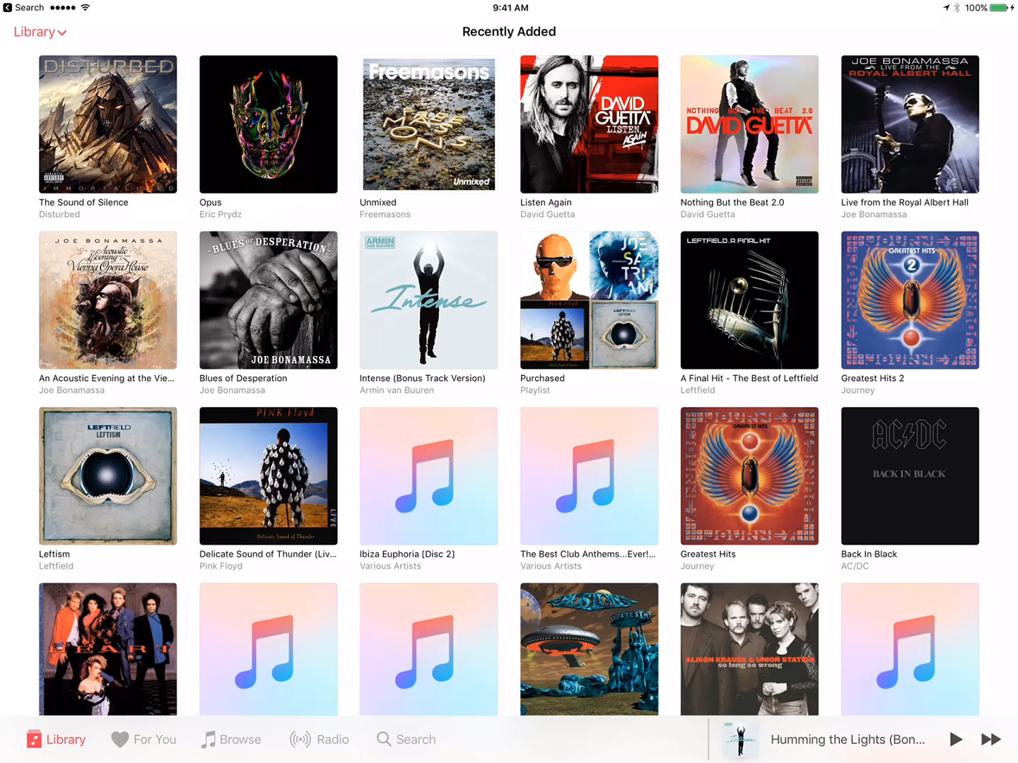
iOS Music

Slide 5
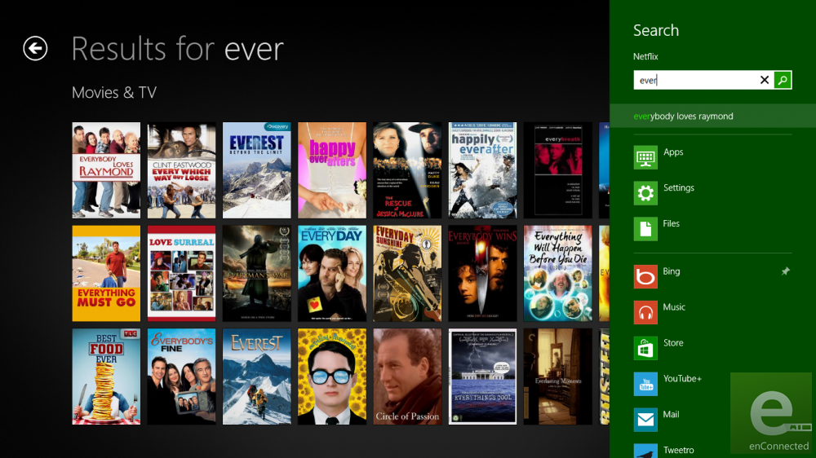
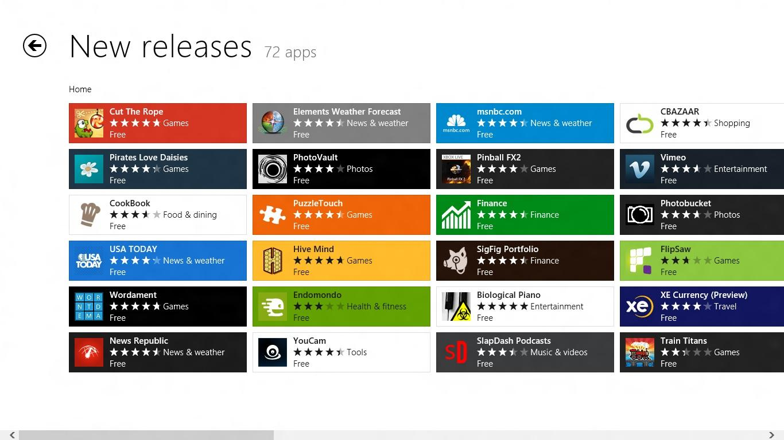
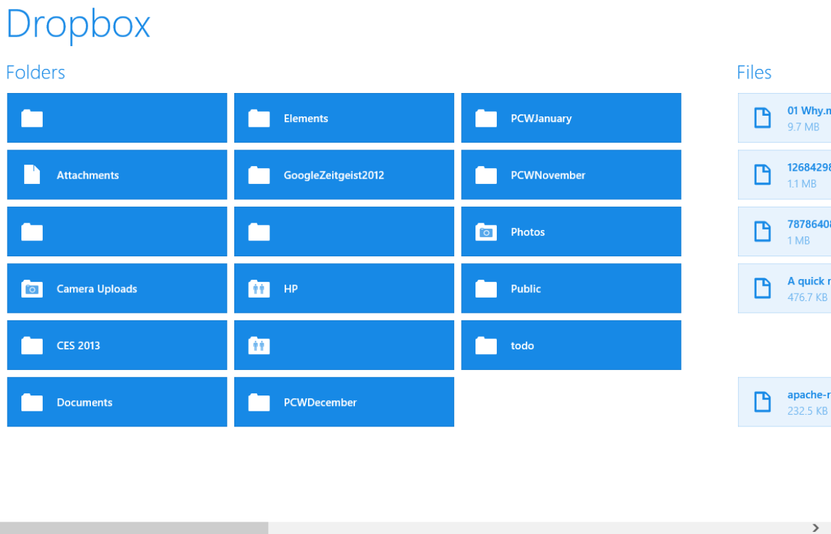
Windows 8 Store Apps…

Slide 6
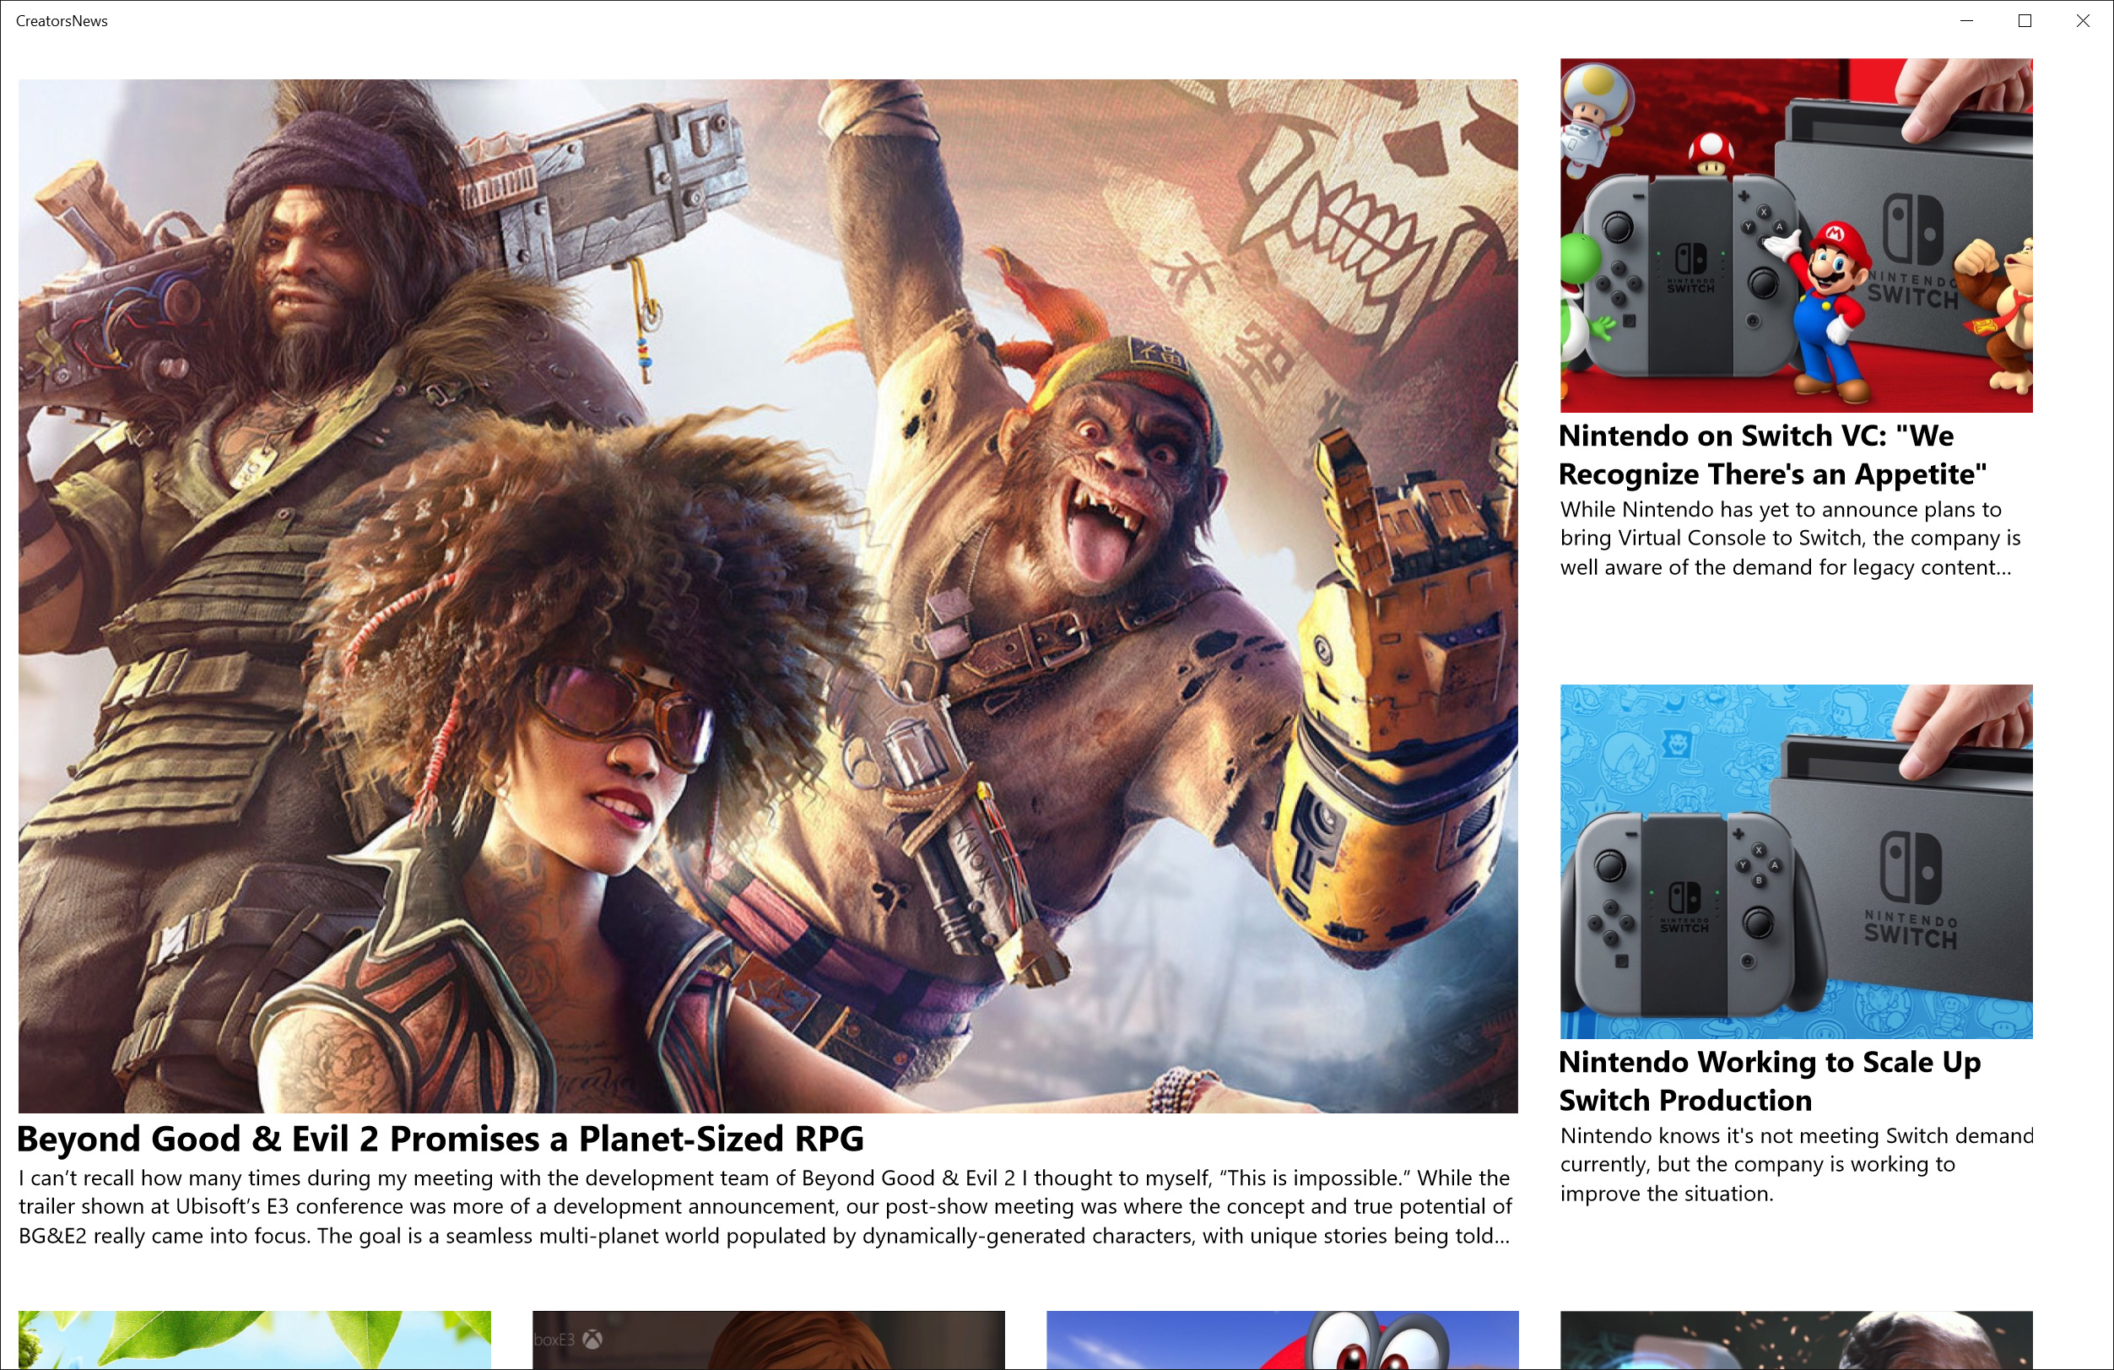
Demo News App

Slide 7
Uninspiring!

Slide 8

So what next?

Slide 9
Let's Light it Up!

Slide 10
References
http://fluent.microsoft.com/
https://docs.microsoft.com/en-us/windows/uwp/composition/visual-layer
https://github.com/Microsoft/WindowsUIDevLabs

